Slide 1

BOOK MY STYLE
NAJMATH M V
MES24MCA-2039
Department of Computer Applications
MES College of Engineering, Kuttippuram
20-08-2025

Slide 2
PRODUCT OWNER NOWSHAD C V ASSISTANT PROFESSOR DEPARTMENT OF COMPUTER APPLICATIONS MES COLLEGE OF ENGINEERING, KUTTIPPURAM

Slide 3
TABLE OF CONTENTS
Introduction
Objective
Existing System
Proposed System
Motivation
Functionalities
Module Description
Developing Environment
Sprint Backlog
Product Backlog
User Story
Project Plans
Data Flow Diagrams
ER Diagram

Slide 4
BOOK MY STYLE
Book My Style is an online platform designed to simplify booking salon appointments.
It addresses common problems like long wait times, phone bookings, and uncertainty of availability.
The system allows users to easily browse salons, services, and staff availability.
Customers can select preferred services and professionals for a personalized experience.
The platform provides real-time updates and notifications to keep users informed.
Salon owners can efficiently manage appointments, staff schedules, and services.
Admins have full control over the system with management and analytics tools.

Slide 5
OBJECTIVES
Create a user-friendly online platform for convenient salon appointment booking, eliminating phone calls and wait times.
Allow customers to browse salons, choose services, select preferred professionals, and receive real-time updates and notifications.
Enable salon owners to manage appointments, staff schedules, and services efficiently through a dedicated dashboard.
Provide admin control with analytics for effective platform management.
Develop the system using modern web technologies to ensure a responsive and seamless user experience
Improve service quality by reducing errors, saving time, and bridging the gap between clients and beauty service providers.

Slide 6
EXISTING SYSTEM
Booking done mainly through phone calls or walk-ins.
Customers face long wait times and uncertainty about availability.
Salon owners manage appointments manually, leading to scheduling conflicts.
Limited or no online presence for salons.
No real-time updates or notifications for customers.

Slide 7
PROPOSED SYSTEM
Online platform for easy and quick salon appointment booking.
Customers can browse salons, services, and staff availability anytime.
Real-time updates and notifications keep customers informed.
Salon owners manage appointments and staff schedules digitally.
Admin panel for overall management and analytics.
Reduces errors, saves time, and improves booking efficiency

Slide 8
MOTIVATIONS
Traditional salon bookings are slow and inconvenient.
Customers face long waits and uncertain availability
Manual management causes errors and conflicts.
There is a need for a simple, digital booking solution.
Improve customer experience and salon management through technology.

Slide 9
FUNCTIONALITIES
Write Project Functionalities with short description using bullet points (1 to 2 Slide)

Slide 10
MODULE DESCRIPTION
Write Module Descriptions using bullet points (1 to 2 Slide)

Slide 11
DEVELOPING ENVIRONMENT
Write the software tools/technologies used for developing the project like Operating System, Front End, Back End, Database, Framework, IDE etc..

Slide 12
SPRINT BACKLOG
Backlog tem | Status And Completion Date | Original Estimation in Hours | Day 1 hrs | Day 2 hrs | Day 3 hrs | Day 4 hrs | Day 5 hrs | Day 6 hrs | Day 7 hrs | Day 8 hrs | Day 9 hrs | Day 10 hrs
SPRINT1
Table designing | 16/8/2022 | 2 | 1 | 1 | 0 | 0 | 0 | 0 | 0 | 0 | 0 | 0
Form designing | 22/8/2022 | 3 | 1 | 1 | 1 | 0 | 0 | 0 | 0 | 0 | 0 | 0
Coding | 27/8/2022 | 3 | 1 | 1 | 1 | 0 | 0 | 0 | 0 | 0 | 0 | 0
SPRINT 2
Data collection | 13/9/2022 | 7 | 1 | 1 | 1 | 1 | 1 | 1 | 1 | 0 | 0 | 0
Data processing | 29/9/2022 | 7 | 1 | 1 | 1 | 1 | 1 | 1 | 1 | 0 | 0 | 0
The table given above is for reference only. Update/create a table with your data.

Slide 13
SPRINT BACKLOG
Backlog tem | Status And Completion Date | Original Estimation in Hours | Day 1 hrs | Day 2 hrs | Day 3 hrs | Day 4 hrs | Day 5 hrs | Day 6 hrs | Day 7 hrs | Day 8 hrs | Day 9 hrs | Day 10 hrs
SPRINT3
Course contents | 3/10/2022 | 7 | 1 | 1 | 1 | 1 | 1 | 1 | 1 | 0 | 0 | 0
Assassement | 20/10/2022 | 7 | 1 | 1 | 1 | 1 | 1 | 1 | 1 | 0 | 0 | 0
SPRINT 4
Certificate | 8/11/2022 | 7 | 1 | 1 | 1 | 1 | 1 | 1 | 1 | 0 | 0 | 0
Testing | 15/11/2022 | 7 | 1 | 1 | 1 | 1 | 1 | 1 | 1 | 0 | 0 | 0
TOTAL |  | 50 | 9 | 9 | 8 | 6 | 6 | 6 | 6
The table given above is for reference only. Update/create a table with your data.

Slide 14
PRODUCT BACKLOG
ID | NAME | PRIORITY <high/medium/low> | ESTIMATE (Hours) | STATUS <Planned/In progress/Completed>
1 | REGISTRATION | High | 5 | COMPLETED
2 | LOGIN | High | 5 | COMPLETED
3 | CRUD(Course,Student,University) OPERATIONS | High | 20 | COMPLETED
4 | STUDENT ENROLLMENT | High | 10 | COMPLETED
5 | CERTIFICATE GENERATION | MEDIUM | 10 | COMPLETED
The table given above is for reference only. Update/create a table with your data.

Slide 15
USER STORY
User Story ID | As a type of User | I want to <Perform some task> | So that i can <Achieve Some Goal>
1 | ADMIN | Login | login successful with correct username and password
2 | ADMIN | View and Manage | Can view and Manage registered users,Faculties and Universities
3 | ADMIN | Verification | Verify Courses
4 | USER | Register | Can users register
5 | USER | Login | login successful with correct username and password
6 | USER | Enrollment | Can enroll in any Courses
7 | USER | View Profile | View users profile in application
The table given above is for reference only. Update/create a table with your data.

Slide 16
PROJECT PLAN
User StoryID | Task Name | Start Date | End Date | Days | Status
1 | Sprint 1 | 16/08/2022 | 17/08/2022 | 10 | Completed
4 |  | 18/08/2022 | 19/08/2022 |  | Completed
5 |  | 20/08/2022 | 22/08/2022 |  | Completed
10 |  | 23/08/2022 | 24/08/2022 |  | Completed
11 |  | 25/08/2022 | 27/08/2022 |  | Completed
2 | Sprint 2 | 13/09/2022 | 23/09/2022 | 16 | Completed
7 |  | 23/09/2022 | 24/09/2022 |  | Completed
12 |  | 24/09/2022 | 29/09/2022 |  | Completed
The table given above is for reference only. Update/create a table with your data.

Slide 17
PROJECT PLAN
User StoryID | Task Name | Start Date | End Date | Days | Status
3 | SPRINT 3 | 03/10/2022 | 06/10/2022 | 14 | Completed
6 |  | 07/10/2022 | 10/10/2022 |  | Completed
13 |  | 13/10/2022 | 20/10/2022 |  | Completed
14 | SPRINT 4 | 28/10/2022 | 5/11/2022 | 10 | Completed
8 |  | 7/11/2022 | 11/11/2022 |  | Completed
9 |  | 13/11/2022 | 15/11/2022 |  | Completed
The table given above is for reference only. Update/create a table with your data.

Slide 18
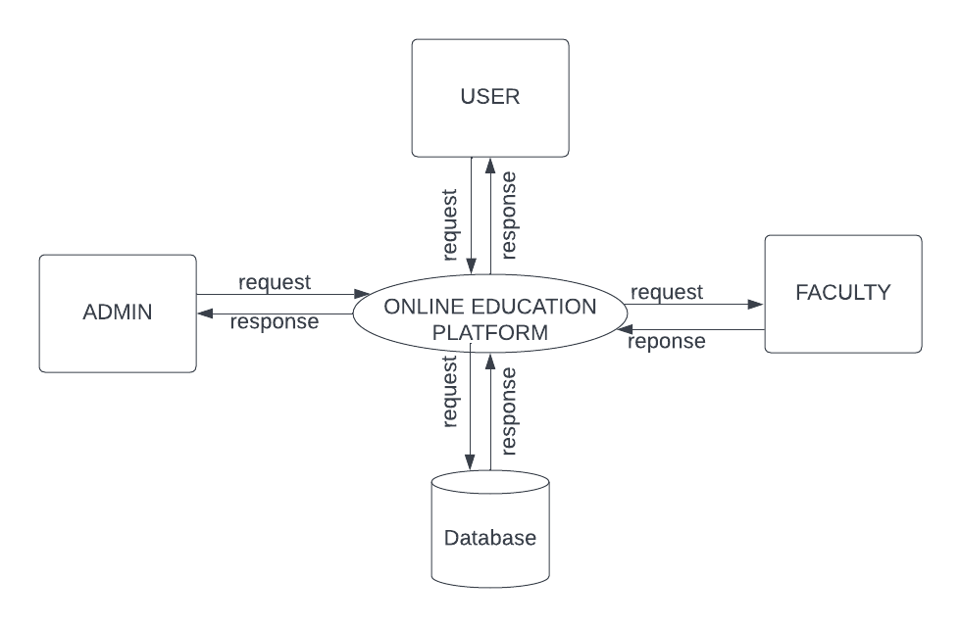
DATA FLOW DIAGRAM
LEVEL 1
The figure given above is for reference only. Create a figure with your data.

Slide 19
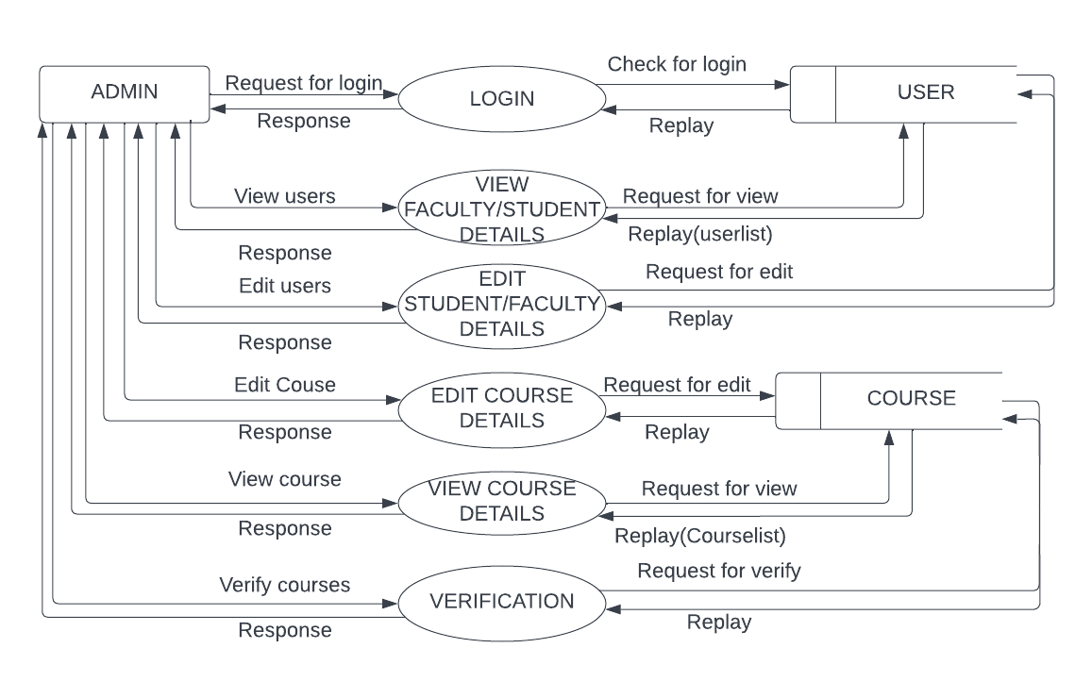
DATA FLOW DIAGRAM
Level 1.1
The figure given above is for reference only. Create a figure with your data.

Slide 20
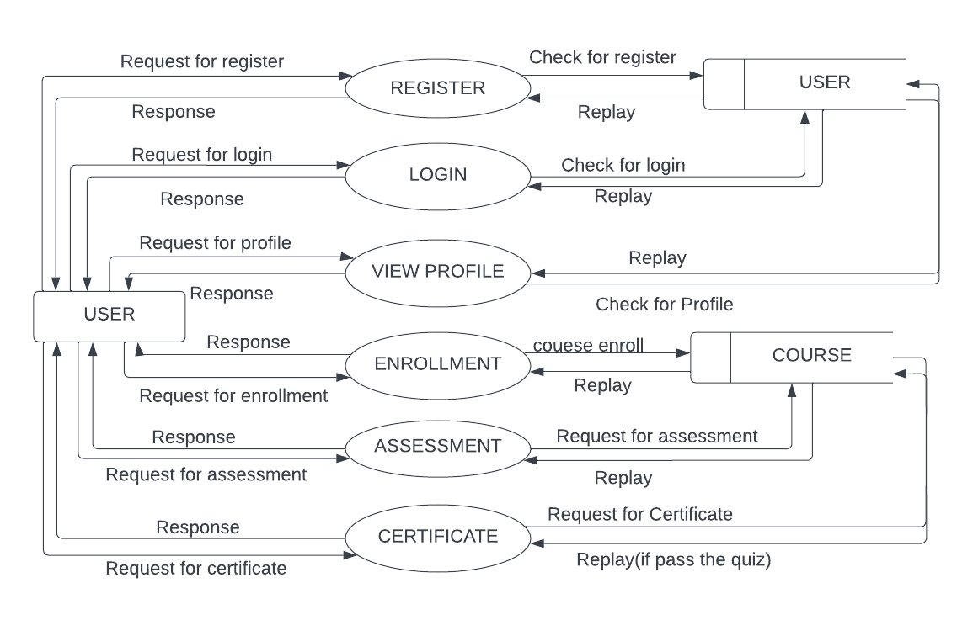
DATA FLOW DIAGRAM
Level 1.2
The figure given above is for reference only. Create a figure with your data.

Slide 21
ER DIAGRAM
Place you ER Diagram (if any) here.

Slide 22
THANK YOU

